Slide 1

The Rise of Fake News in the Political Scene
By Michael Mahoney

Slide 2

Presentation Overview
Quick intro to the data
Talk about misinformation and what we found
Explore some recommendations
Talk about the future

Slide 3

Who is This Presentation For
Notes:
The short answer is everyone but some should be more tunned in than others.
Social Media Companies
Journalists who work in the political realm
Politicians and their staff

Slide 4

Misinformation
The Cost 79 Billion USD
37 billion USD in losses on the stock market
17 billion USD in losses annually from false/misleading financial information
9.54 billion USD spent on reputation management for false information about companies.
3 billion USD has been already spent to combat fake news.
400 million USD spent by US public institutions defending against misinformation.
250 USD million spent on brand safety measures.
Notes:
In the study titled “The Economic Cost Of Bad Actors On The Internet: Fake News 2019, ” author Professor Roberto Cavazon from the University of Baltimore explores the cost of fake news from a high level perspective. The economic effects have hit every sector of the economy. As social media sites are the host for much of the content that circulates, they have already begun to invest in moderation to help fight mis-information. Facebook invested 3 billion USD in 2018 and has stated more investment is on the way.

Slide 5
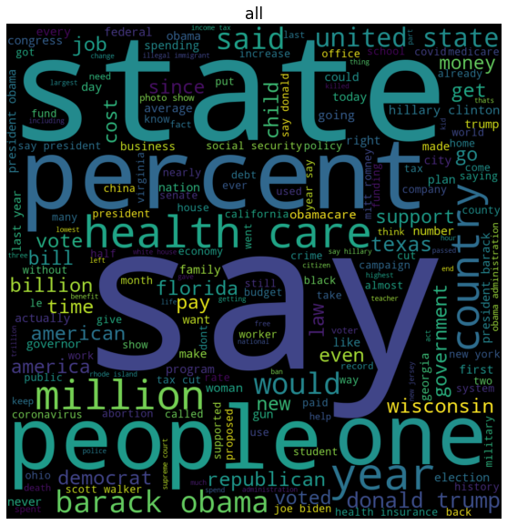
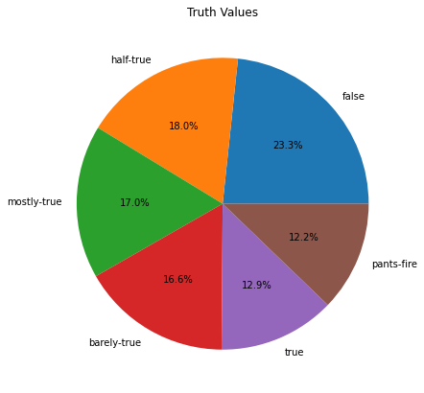

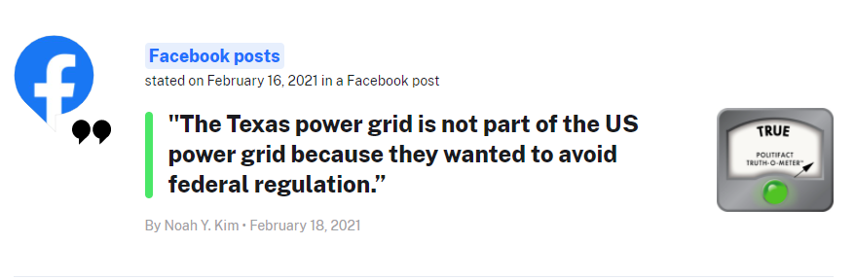
Our Data
Notes:
The data was pulled from a website called Politifact.com. PolitiFact researches political and social context that is impactful to the public. Almost all of the content comes in the forms of quotes or general statement. I will generally refer to individual pieces of text as a quote.
In total there were around 18500 quotes that fell into 6 distinct categories. The most numerous is the “false” category and the least numerous was the “pants-fire” category.
Pants-fire is truly a subcategory of false including quotes that were false with the added caveat of being particularly outlandish.
Shown is an example of a Politifact.com fact check. On the website you can click the quote and pull up the article that explains the rating given.

Slide 6
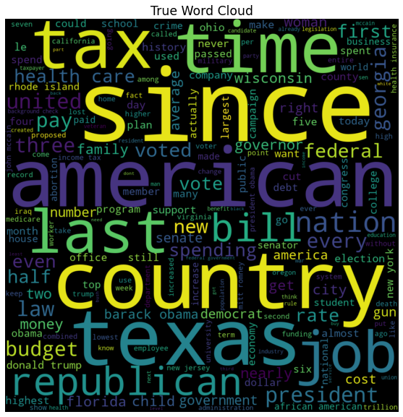
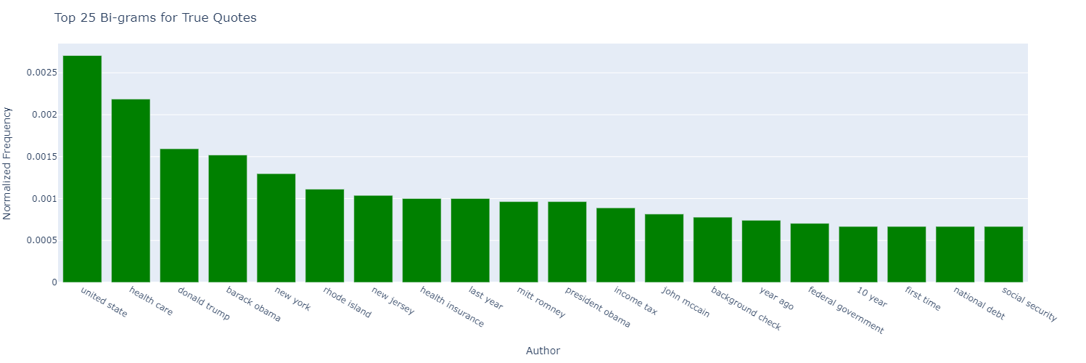
True
Word pairs that are unique in the top 25:
Per capita
West Virginia
National debt
10 year
John McCain
Rhode Island
Notes:
In addition to the unique word pairs, here are some statistics
General Statistics
5 of 25 include individuals or mentions of individuals (20%)
8 of 25 are political/social issues (32%)
3 are states (12%)
3 are number based (12%)
0 include the word "says" (0%)

Slide 7
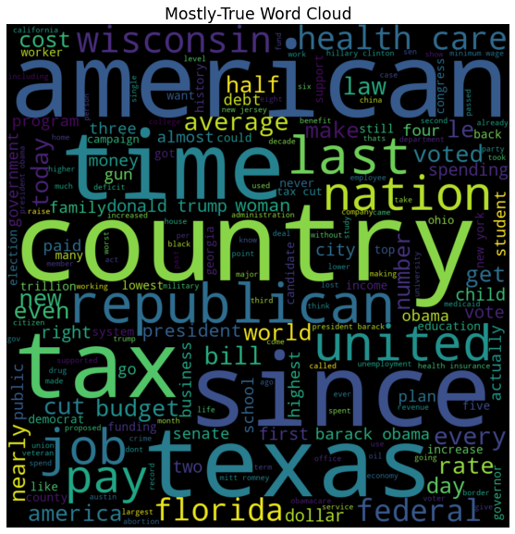
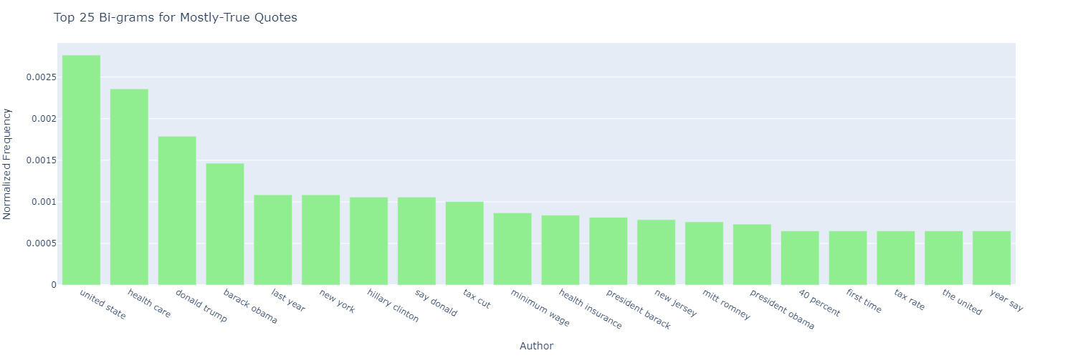
MOSTLY-TRUE
Word pairs that are unique in the top 25:
50 percent
1 percent
Million people
Tax Rate
Notes:
In addition to the unique word pairs, here are some statistics
General Statistics
7 of 25 include individuals or mentions of individuals (28%)
7 of 25 are political/social issues (28%)
2 are states (8%)
3 are number based (12%)
1 includes the word "says" (4%)

Slide 8
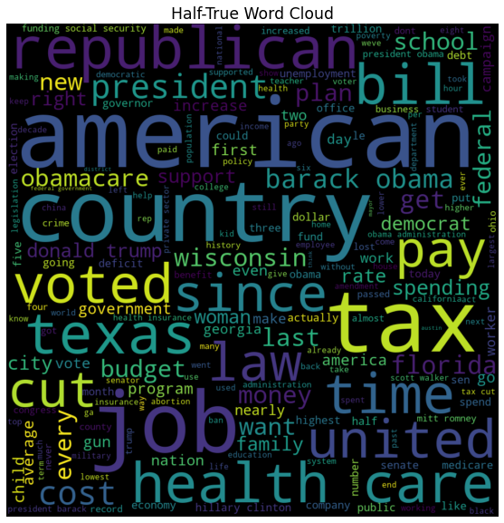
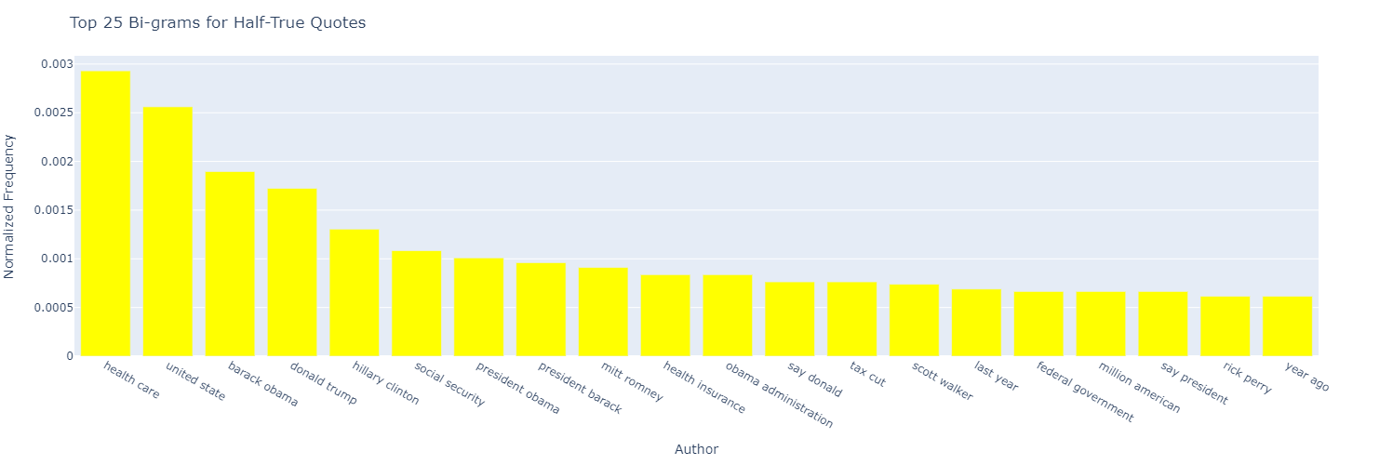
HALF-TRUE
Word pairs that are unique in the top 25:
Cares act
Unemployment rate
Million jobs
Rick Perry
Million Americans
Notes:
In addition to the unique word pairs, here are some statistics
10 of 25 include individuals or mentions of individuals (40%)
5 of 25 are political/social issues (20%)
0 are states (0%)
2 are number based (8%)
2 include the word "says" (8%)

Slide 9
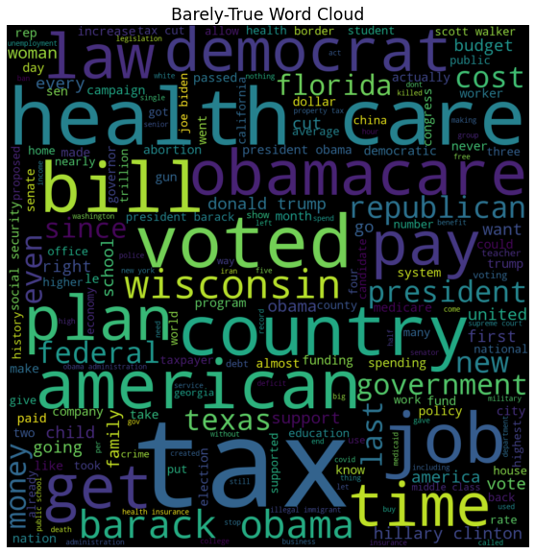
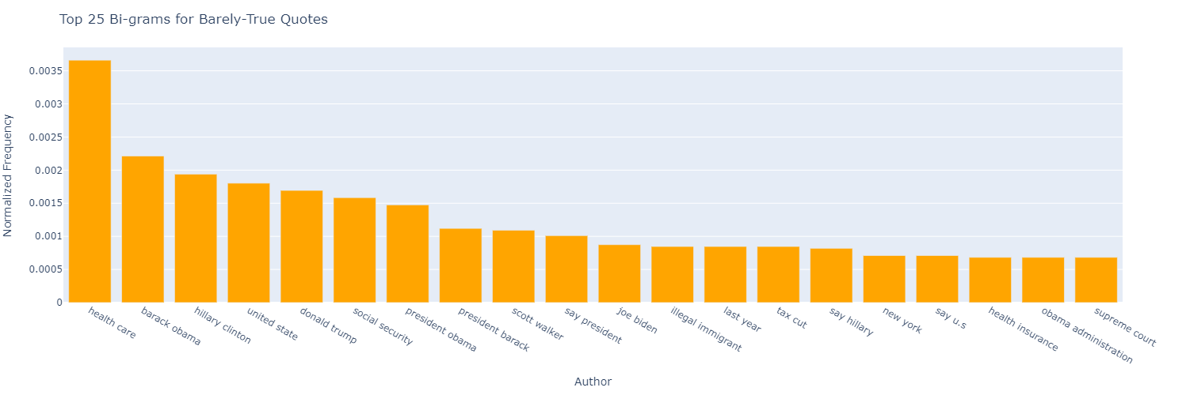
BARELY-TRUE
Word pairs that are unique in the top 25:
Rick Scott
Property tax
Public school
Notes:
In addition to the unique word pairs, here are some statistics
10 of 25 include individuals or mentions of individuals (40%)
6 of 25 are political/social issues (24%)
1 is a state (4%)
1 is number based (4%)
3 include the word "says" (12%)

Slide 10
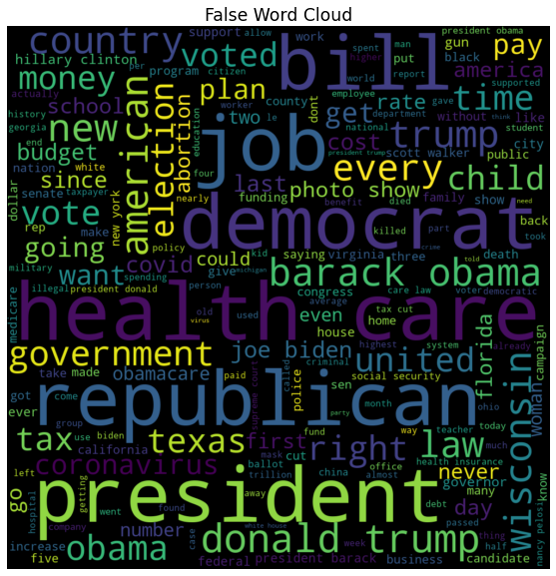
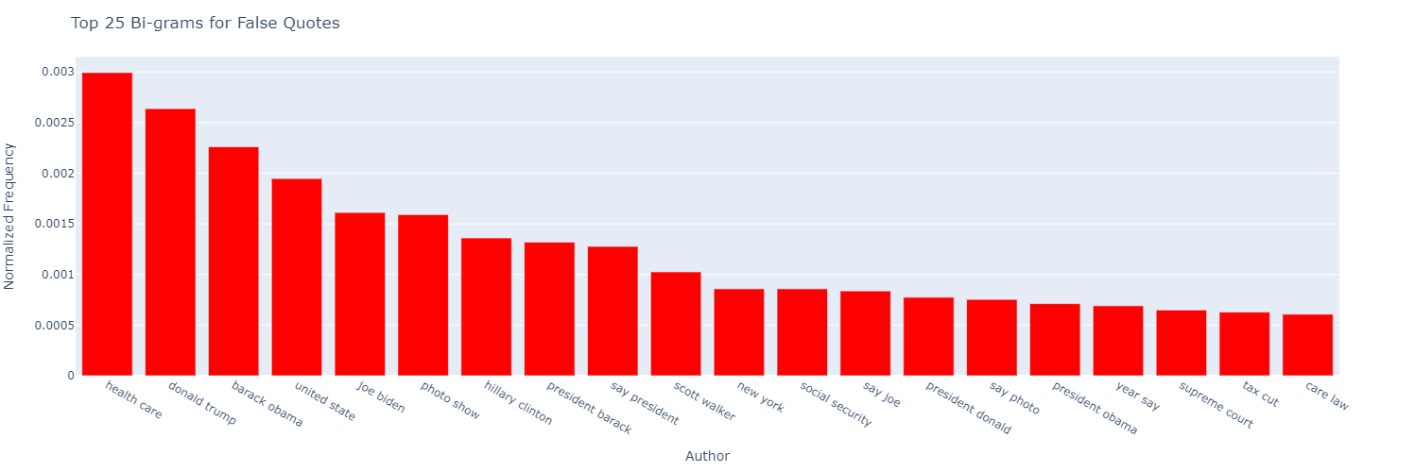
False
Has no unique word pairs in the top 25
Notes:
In addition to the unique word pairs, here are some statistics
10 of 25 include individuals or mentions of individuals (40%)
6 of 25 are political/social issues (24%)
1 is a state (4%)
0 are number based (0%)
2 talk about photos (8%)
3 include the word "says" (12%)

Slide 11
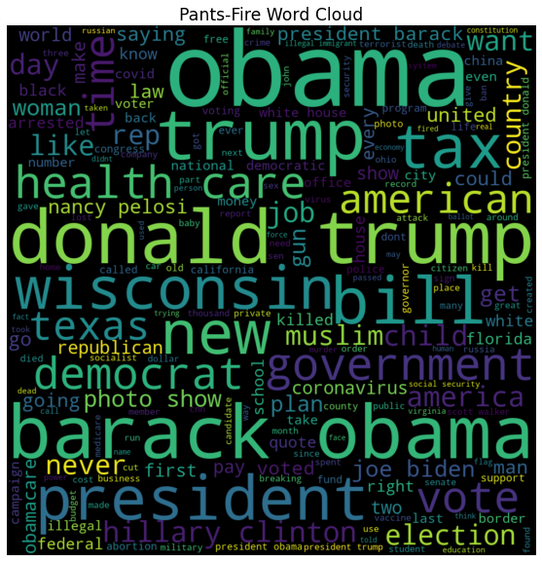
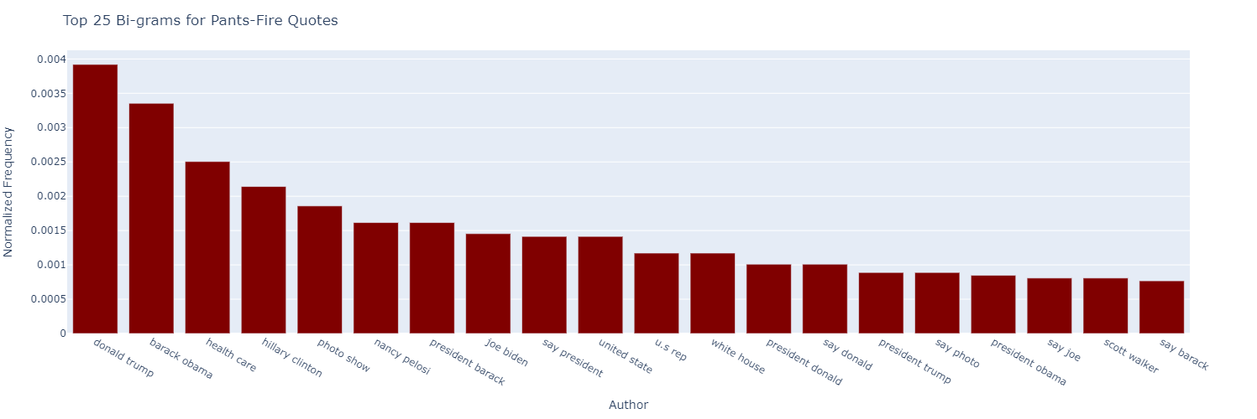
PANTS-FIRE
Word pairs that are unique in the top 25:
George Soros
Says Barack
Nancy Pelosi
Notes:
In addition to the unique word pairs, here are some statistics
15 of 25 include individuals or mentions of individuals (60%)
2 of 25 are political/social issues (8%)
0 are states (0%)
0 are number based (0%)
2 talk about photos (8%)
5 include the word "says" (20%)

Slide 12
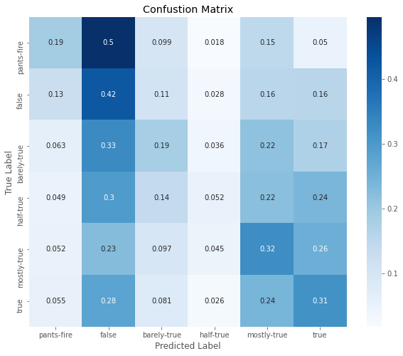
MODELS
LSTM with Non-Lemmatized Tokens
Accuracy: 26%
Notes:
The best performing model to date was the LSTM neural network with non-lemmatized tokens. Don’t worry if you don’t know what this means! I tried many different types of models and I wanted to make sure to call out the winner.
Looking at the confusion matrix, the categories are logically ordered from left to right with pants-fire on the left and getting progressively more truthful with true on right. The total accuracy of the model was 26% with false, mostly-true and true being the best performing categories. Because pants-fire is more of a subset of the false category, I’m not disappointed at the misclassification between the two. Ultimately, the distinction between false and outlandishly false is more academic than practical.

Slide 13
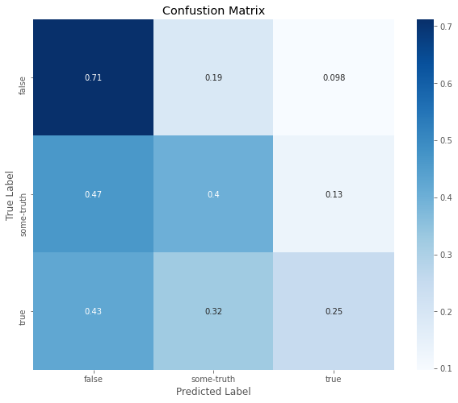
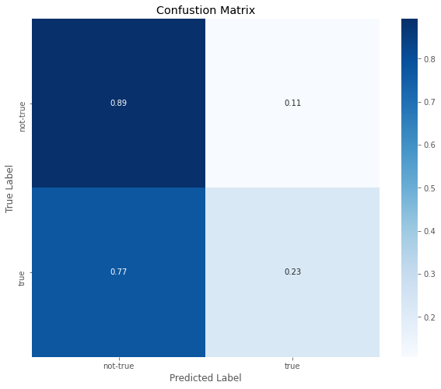
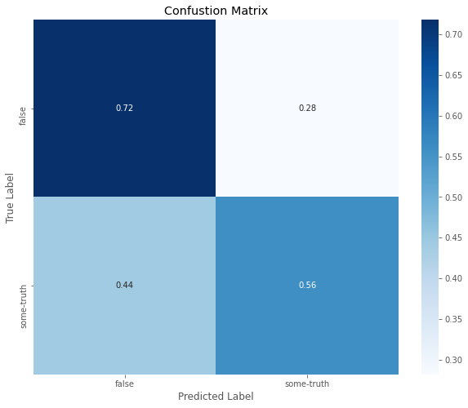
MODELS
LEFT Model:
Pants-fire & False mapped to false
True mapped to true
Everything else mapped to some-truth
MIDDLE Model:
True mapped to true
Everything else mapped to not-true
RIGHT Model:
Pants-fire & False mapped to false
Everything else mapped to not-false
Notes:
Because of the lackluster performance of the 6 category model I thought it prudent to collapse labels into a coarser structure. The attempt was to try and increase total model accuracy without compromising the practicality of the model. Here’s how I combined the labels.
LEFT Model:
Pants-fire & False mapped to false
True mapped to true
Everything else mapped to some-truth
MIDDLE Model:
True mapped to true
Everything else mapped to not-true
RIGHT Model:
Pants-fire & False mapped to false
Everything else mapped to not-false
Once again, it’s clear that the false categories are captured at a higher rate than any other category. Of all the label mappings, the model to the far right is the most useful, being able to spot 72% of all false quotes. This process is not very precise yet, hence, why I claim it is not ready for a production environment.

Slide 14
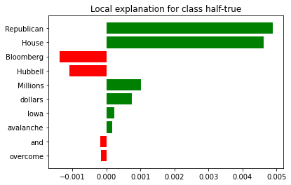
Example Classification
Half-True Example
Millions of Hubbell and Bloomberg dollars wasn’t enough to overcome the Iowa House Republican avalanche of success.'
Notes:
Here we see an example of a correct classification by our model (half-true). The graph on the right show which words pushed the model towards classifying half-true – green – and which pushed the model away from half-true – red. Because we are dealing with a multi-class problem the direction in which the red words push the model isn’t exactly clear, the best we can say at a high level is “away from picking the half-true label.”
What about the words that aren’t highlighted? Does this mean the model ignored them?
Not exactly. The model uses every word during the classification task. In the case of the unhighlighted words, the model determined that their affect on picking half-true is so small that they aren’t worth showing in the graph. In some cases, we’re talking about considering down the 32nd decimal place.

Slide 15

What to do about it?

Slide 16

Resource Dedication
For those wishing to devote resources to fight misinformation; Mentions of photo content were only mentioned in the top 25 word pairs for the false and pants-fire categories. Flagging content with mentions of photos (not necessarily photos themselves) will lead to capturing more mis-information.
Notes:
Resource dedication should also be used to investigate further based on phrasing using specific words. This ideology fits with the fact that mis information and information have target audiences that respond to certain phrases or words. As discussed, photo shows/ photo says only appears in the false and pants-fire categories. Other relational phrases may be the key to determining the phrasing that makes misinformation so addictive to the intended target audience.

Slide 17

Politics
For politicians, people and not so much issues find themselves as common associations with misinformation (with the notable exception of health care). If you wish to advance legislation, decoupling the issue from individuals will the best way to limit misinformation's impact.

Slide 18

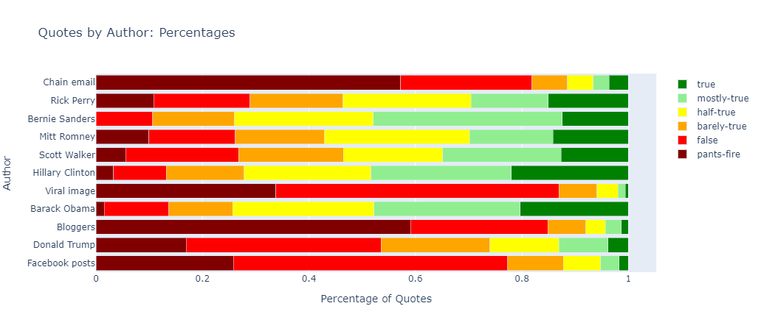
Perpetuating Information
For Journalists, bloggers and people at large: Email chains, unattributed social media posts and viral content should never be used as a source for content.
Notes:
In terms of percentages, social media sites and other forms of digital communication rank at the top of the sources whose reviewed quotes are disproportionally false. The image above is a sample that gives some perspective. It’s not uncommon for such sources to be 75%+ false in nature with 5% or less of completely true statements. The one exception to this are tweets which are attributed to the posting author and not general categories. The takeaway here is that general attention-grabbing statements without clear authors or intentionally vague organizations should never be cited due to their overwhelming likeliness to be incorrect.

Slide 19

Future Work
I would like to bring in some more quotes.
The second modeling goal is to implement a version of a BERT transformer.
As for the data exploration; I would like to make more use of the various NLTK apis for text engineering.
I would like to make the data more interactive on the app such that users can select specific quotes and interact with them through the various text models.

Slide 20
References
Politifact.com They are awesome and you should consider donating!
Ashish Vaswani, Noam Shazeer, Niki Parmar, Jakob Uszkoreit, Llion Jones, Aidan N. Gomez, Lukasz Kaiser, Illia Polosukhin: Attention is All you Need. NIPS 2017: 5998-6008
Jacob Devlin, Ming-Wei Chang, Kenton Lee, Kristina Toutanova: BERT: Pre-training of Deep Bidirectional Transformers for Language Understanding. NAACL-HLT (1) 2019: 4171-4186
Keras Developers: Keras API Docs: https://keras.io/api/
Ployly Developers: Plotly API Docs: https://dash.plotly.com/
Scikit Learn Developers: Scikit Learn API Docs: https://scikit-learn.org/stable/modules/classes.html
Pandas Developers: Pandas API Docs: https://github.com/pandas-dev/pandas
Jacob Kessler: ScatterText: https://github.com/JasonKessler/scattertext
Marco Tulio Correia Ribeiro: Lime: https://github.com/marcotcr/lime
Radim Rehrek, Petr Sojka: Software Frameword for Topic Modelling with Large Corpora: Proceedings of the LREC 2010 Workshop on New Challenges for NLP Frameworks: p. 45 - 50 : 2010: ELRA: Valletta, Malta
Andreas Mueller: word-cloud: https://github.com/amueller/word_cloud

Slide 21

Thank you

